Slide 1
Food Portfolio
P.Nalini
STUDENT NAME:
REGISTER NO AND NMID:
DEPARTMENT:
COLLEGE: COLLEGE/ UNIVERSITY
83BEA100D49FC63AA03440AD50AA92CC
Bsc Computer Science
C.S.I Ewart Women's Christian college
Madras University

Slide 2
PROJECT TITLE
Food portfolio using front end web development

Slide 3
AGENDA
Problem Statement
Project Overview
End Users
Tools and Technologies
Portfolio design and Layout
Features and Functionality
Results and Screenshots
Conclusion
Github Link
3/21/2024 Annual Review

Slide 4
PROBLEM STATEMENT
Despite sufficient global food production, millions of people still suffer from hunger and malnutrition due to unequal distribution, food waste, and poor storage and transportation systems. At the same time, a large amount of food is lost or wasted at various stages from farm to table, contributing to environmental and economic challenges. Addressing this issue requires sustainable solutions to improve food access, reduce waste, and ensure food security for a

Slide 6
WHO ARE THE END USERS?
1.Restaurants and cafés also act as end users.
2.Hospitals, schools, and institutions use food to feed patients, students, or staff
3.They buy ingredients to cook and serve meals to customers

Slide 7
TOOLS AND TECHNIQUES
Food storage – refrigerator, airtight containers, freezer.
Food safety – thermometer, gloves, clean utensils.
Preparation – washing, peeling, cutting, chopping, grinding.
Safety – proper handwashing, covering food, avoiding contamination.

Slide 8
POTFOLIO DESIGN AND LAYOUT
1.about Me
2.My skills
3.Contact Me
8

Slide 9
FEATURES AND FUNCTIONALITY
1. Navigation bar with smooth scrolling.
2. Project showcase with images.
3. Responsive design for all devices .

Slide 10
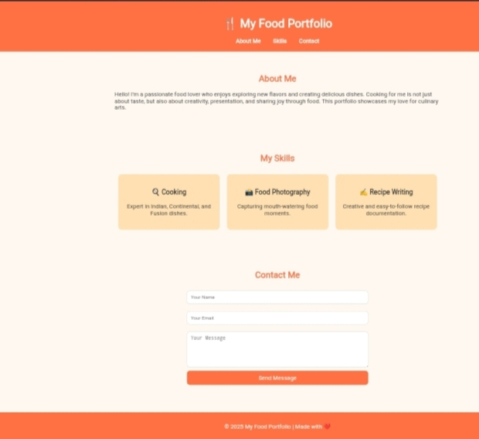
RESULTS AND SCREENSHOTS
3/21/2024 Annual Review
10

Slide 11
CONCLUSION
Food is the foundation of life. Eating safe, nutritious, and balanced food gives us energy, protects us from diseases, and ensures a healthy and happy future.
11

